Slide 1
Recitation: Homework 1, Problem 2
Brandon Lim, Carson Earl, Charlie Ryan, Tristan Leeroff

Slide 2
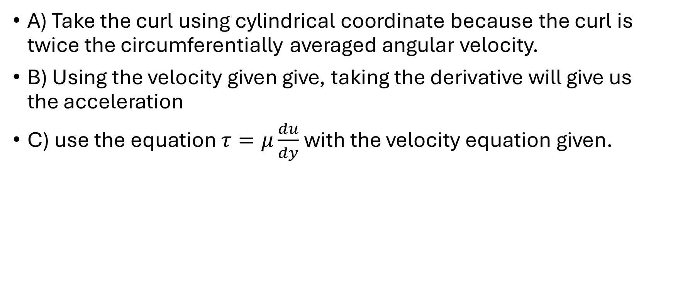
Approach
A) Take the curl using cylindrical coordinate because the curl is twice the circumferentially averaged angular velocity.
B) Using the velocity given give, taking the derivative will give us the acceleration
C) use the equation $τ=μ\frac{du}{dy}$ with the velocity equation given.

